Slide 1


Slide 2

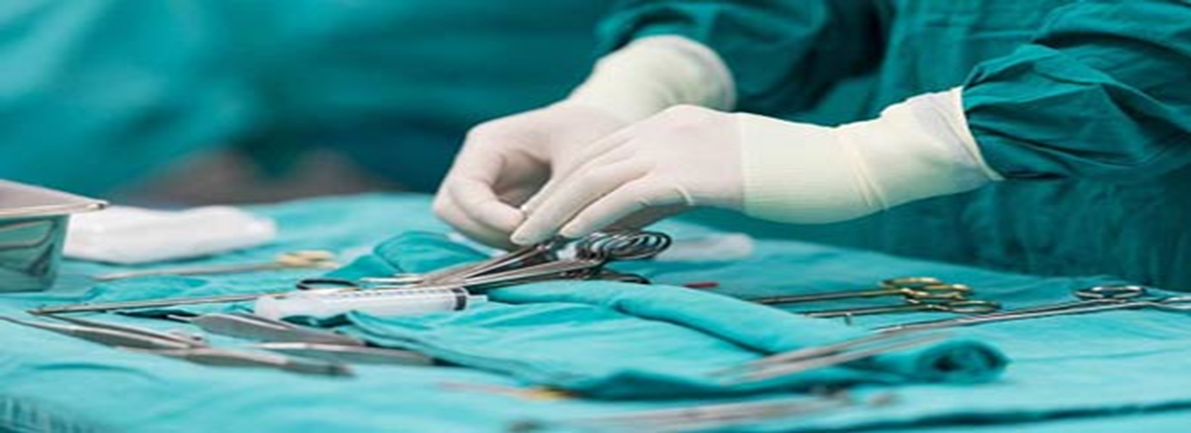

Treatment

Slide 3
INITIAL TREATMENT
Modifying contributory factors
Bladder training
Lifestyle modification :
1 - Weight loss
2 - Dietary changes
3 - Constipation
4 - Smoking cessation

Slide 4
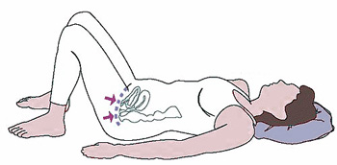

Pelvic muscle exercises (PME) :
Kegle exercises strengthen the muscular urethral closure mechanism.( grade 2A )

Slide 5
Initial instructions:
3 sets of 8 to 12 contractions sustained for 8 to 10 seconds each, performed three times a day. (at least 15 to 20 weeks)
Pelvic floor muscle (Kegel) exercises
Supplemental modalities:
1 - Supervised pelvic floor therapy
2 - Vaginal weighted cones
3 - Biofeedback

Slide 6

Local topical Estrogen:
There is inconsistent evidence whether local topical estrogen ( cream , ring , dissolving tablets) improves incontinence symptoms.( grade 2C)
* Randomized trials have demonstrated that Oral Estrogen worsen urinary incontinence.

Slide 7
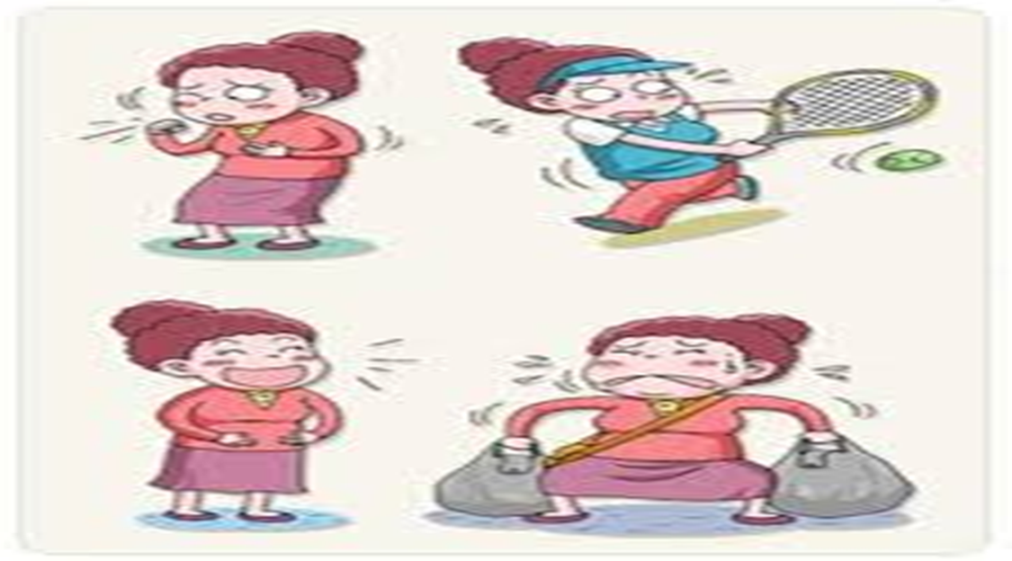
SUI : The involuntary leakage of urine on effort or exertion or on sneezing or coughing
Affects 4%-35% of women

Slide 8
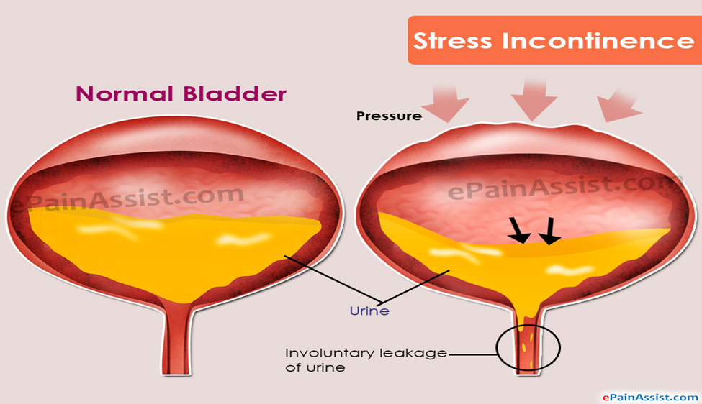
Is achieved when the urethra maintains a pressure greater than bladder pressure. (during a detrusor muscle contraction or an increase in intraabdominal pressure(
Continence

Slide 9
درمان بی اختیاری SUI
درمان کنسرواتیو
تغییر سبک زندگی
رفتار درمانی
درمان جراحی
فیزیو تراپی
پساری
دارویی *
درمان دارویی مورد توافق همگانی نیست.*

Slide 10
Trial of pelvic floor exercises / Lifestyle therapy / Behavioral changes
Supervised or augmented pelvic floor muscle training
It can take 6 to 12 weeks to see an effect from the initial interventions

Slide 11
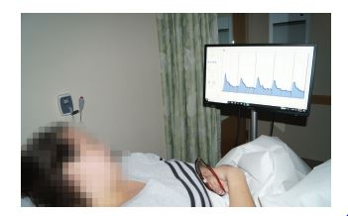
For those who have difficulty or no improvement with unsupervised physical therapy:
Supervised pelvic floor physical therapy by a physical therapist specifically trained in the modalities (Grade 2C)

Slide 12
درمان دارویی SUI
دالوکستین
اندیکاسیون :
- عدم تمایل به جراحی و افسردگی همزمان
سایر داروها
ایمی پرامین
فنیل پروپانول آمین

Slide 13


Slide 14

Incontinence pessaries may improve the symptoms of stress and mixed urinary incontinence but objective evidence regarding their effectiveness has not been reported.

Slide 15

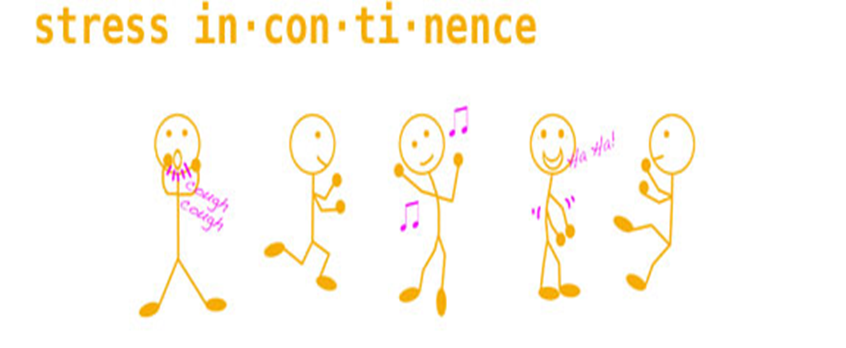
Surgical treatment

Slide 16
Surgical Candidate
Women who decline or have persistent symptoms following conservative therapy
Women with occult SUI

Slide 17
Surgical treatment have consistently been shown to have a higher efficacy rate than conservative therapy.
Surgery is associated with increased morbidity , postoperative voiding difficultly & development or worsening of urgency incontinence

Slide 18
Preoperative counseling
Individual patient goals
Patient & surgeon satisfaction with treatment can be optimized by having a discussion during the planning phase for the surgery
Expectations for her treatment
Awareness of potential adverse events

Slide 19
Sub urethral sling
Mid urethral sling
Bladder neck sling
1 - Retropubic midurethral sling
2 - Transobturator midurethral
sling
3 - Single incision midurethral sling
1 - Pubovaginal slings
2 - Burch colposuspension

Slide 20
PATIENT SELECTION
The MUS is the standard of care for SUI , largely due to the decreases in morbidity and voiding dysfunction associated with MUS as compared with bladder neck slings
** Bladder neck slings are reserved for women :
1 – MUS are contraindicated
2 - Were unsuccessful
3 - Decline to have a synthetic material used for their sling

Slide 21
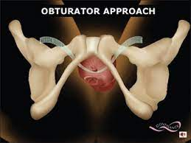
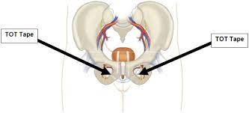
Trans obturator midurethral slings ( TOT )

Slide 22
کاندیدای جراحی TOT
اندیکاسیون
بی اختیاری استرسی علامتدار
کاندید ترمیم پرولاپس آپیکال و مورد شناخته شده یا محتمل بی اختیاری استرس مخفی
کنتراندیکاسیون
عفونت مجاری ادراری
ترجیحاَ انجام نشود
حاملگی*
اختلال انعقادی
آبسه کشاله ران
عفونت مزمن
درد مزمن
ISD
Recurrent incontinence

Slide 23
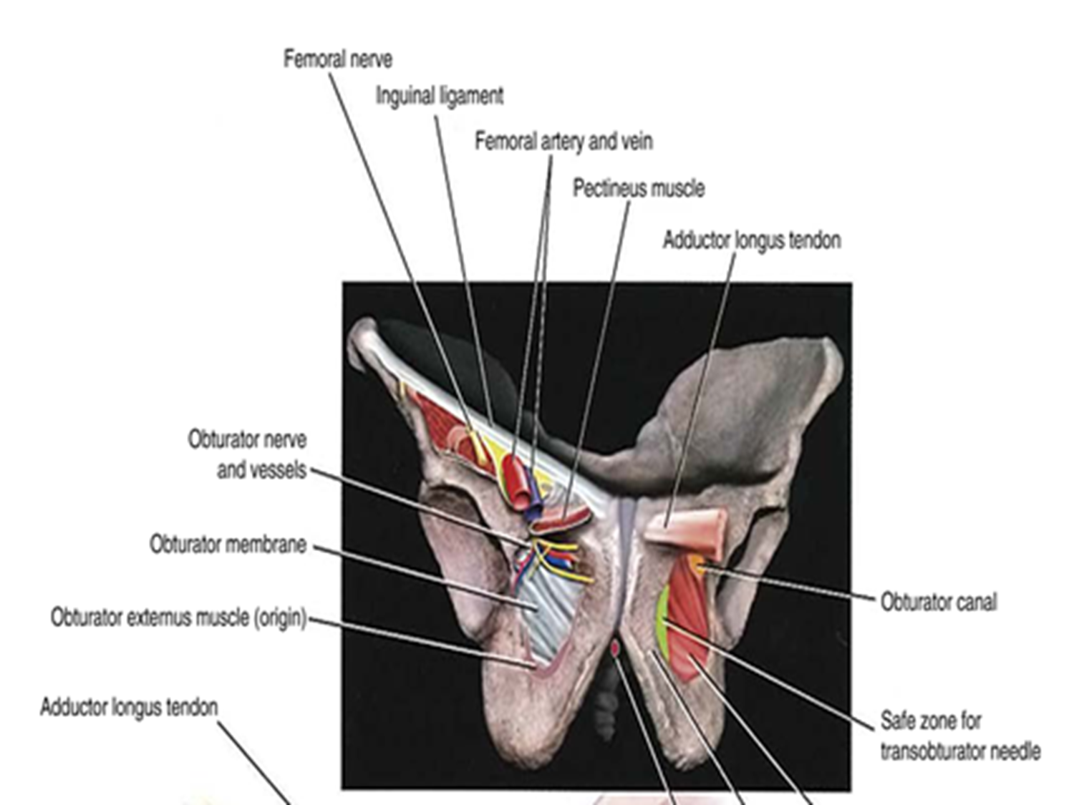

Slide 24
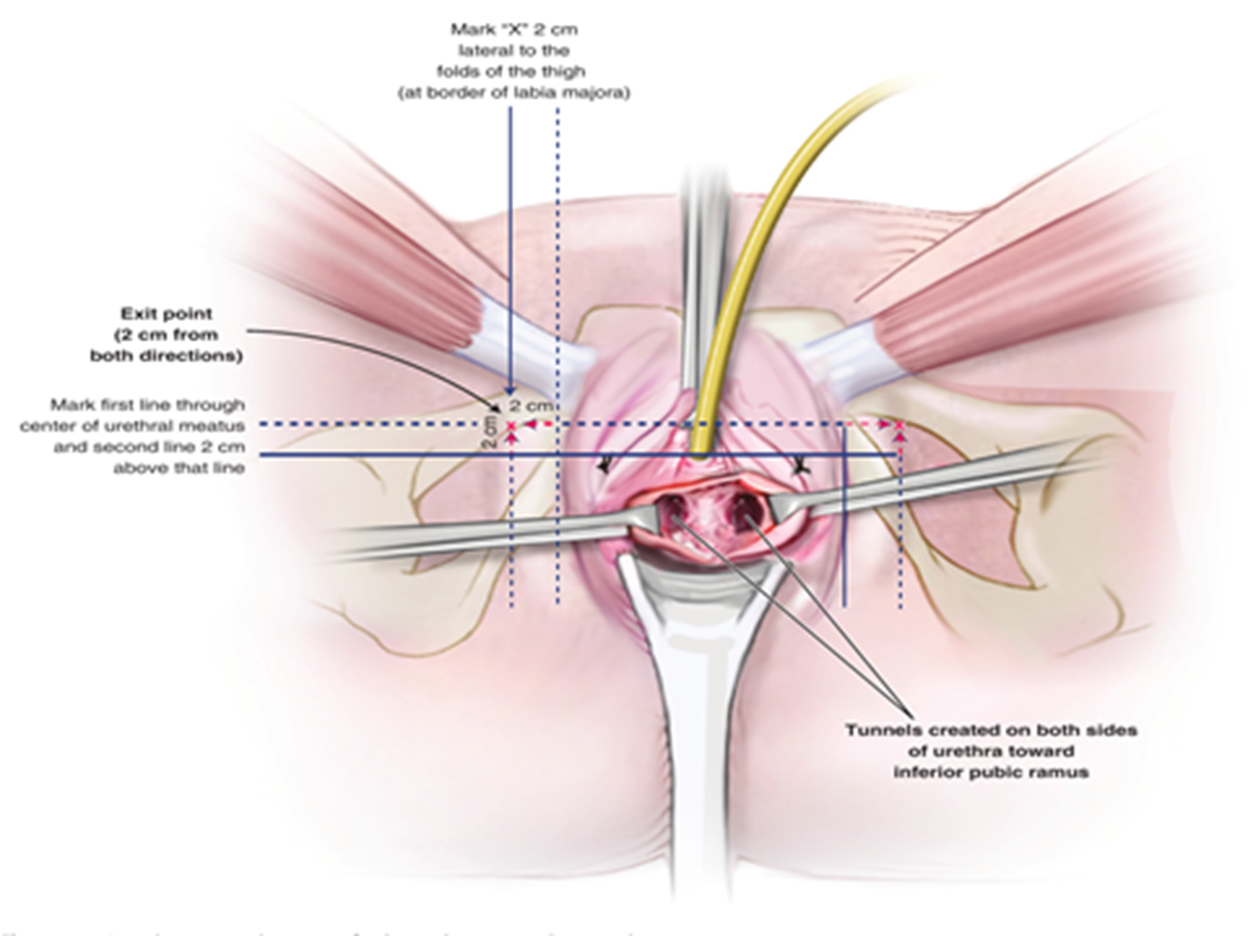

Slide 25
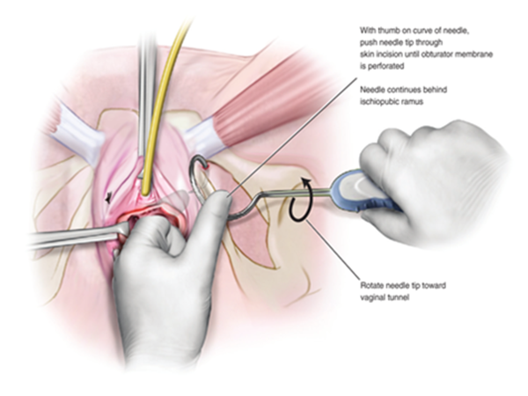

Slide 26
COMPLICATIONS
1 - Persistent stress incontinence
2 - Voiding dysfunction
3 - Urinary urgency
4 - Urinary tract infection
5 - Bladder or urethral injury
Urinary tract

Slide 27
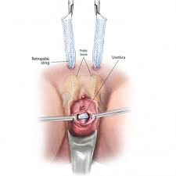
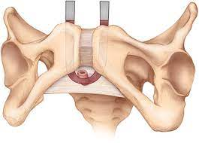
Retropubic midurethral sling ( TVT )

Slide 28
Contraindication
Absolute
Relative
1 - Current urinary tract infection
2 - Current pregnancy
3 - Anticoagulation
4 - Structures in the retropubic space that are in the path of sling placement (vascular graft, bowel, transplanted pelvic kidney)
1 - Plans for future pregnancy
2 – History of a ruptured appendix with peritonitis or stage 4 endometriosis

Slide 29
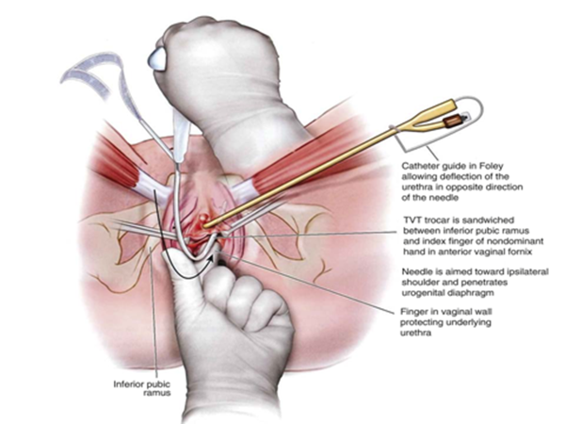

Slide 30
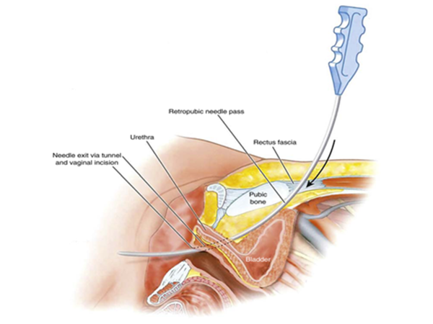
We suggest a bottom-to-top rather than top-to-bottom approach for trocar insertion (Grade 2B)

Slide 31
COMPLICATIONS
1 - Bladder injury
2 - Urethral injury
3 - Urinary tract infection
4 - Voiding dysfunction
5 - Urinary urgency
Urinary tract

Slide 32
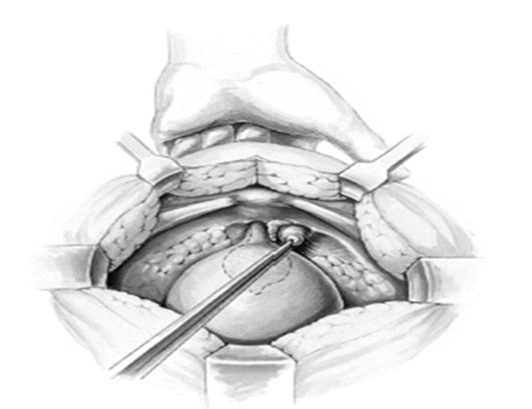
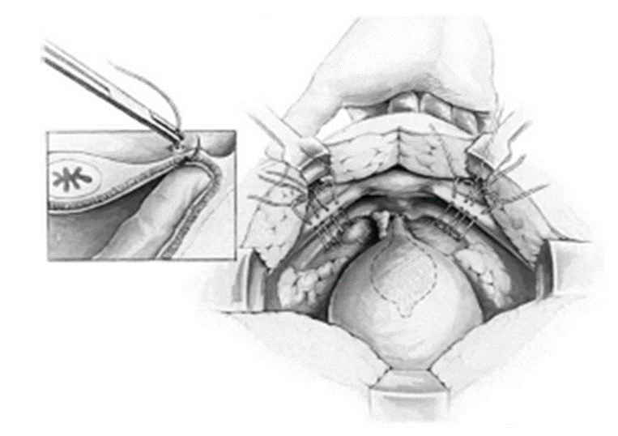
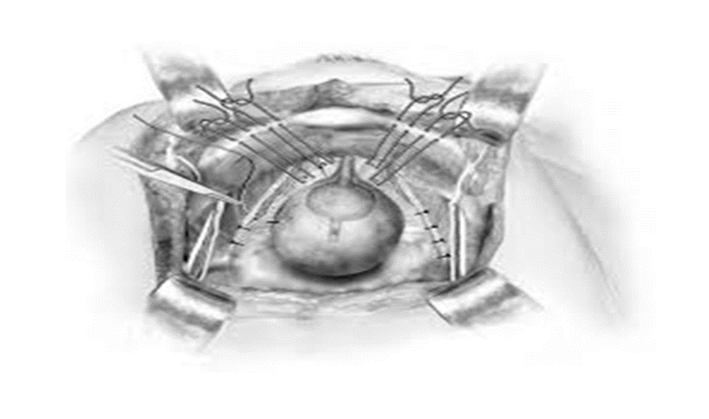
Burch urethropexy

Slide 33
Burchاندیکاسیون
بی اختیاری استرسی علامتدار و تمایل به جراحی شکمی
(لاپاراسکوپی یا لاپاراتومی)
پروفیلاکتیک
پرولاپس پیشرفته که به نظر می رسد دچار پیشرفت بی اختیاری استرسی اداری پس از ساکروکولپوپکسی شکمی می شوند.
بعضی از جراحان ترجیح می دهند که حتی در صورت انجام ساکرو کولپوپکسی شکمی ، از روش اسلینگ میداورترا استفاده کنند .
در زنان بدون هیپرموبیلته اورترا مناسب نیست.

Slide 34
COMPLICATION
1 – Urinary Infection
2 – Bladder Laceration
3 – Urethral Obstruction
4 – Overactive bladder
Urinary Tract

Slide 35
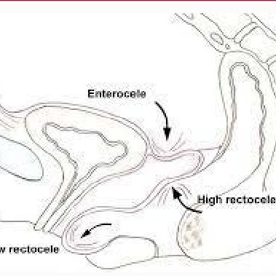
1 – Wound complication
2 – Osteitis pubis
3 – Enterocele & Rectocele

Slide 36
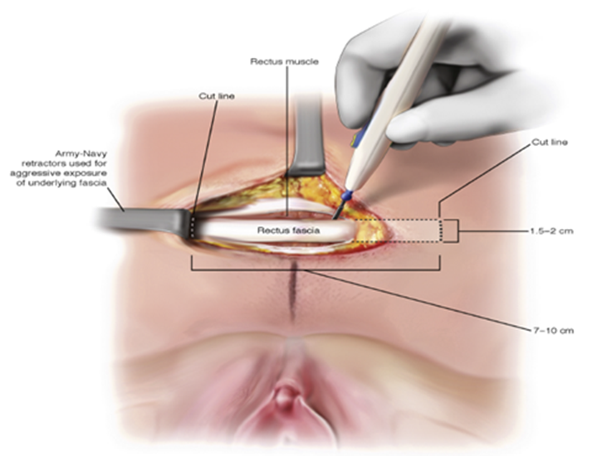
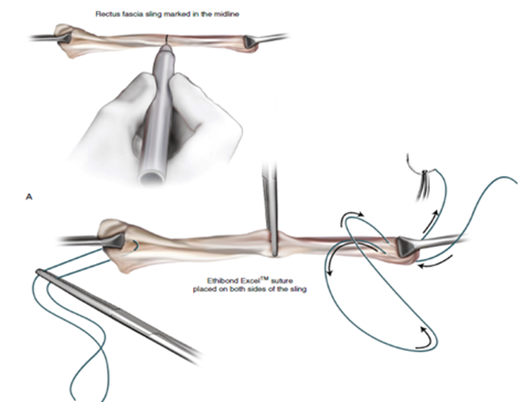
Fascial sling

Slide 37
اسلینگ فاشیایی
اولین خط درمان بی اختیاری ادراری استرسی محسوب نمی گردد.
کنتراندیکه بودن اسلینگ مید اورترا
نا موفق بودن اسلینگ میداورترا قبلی
عدم تمایل بیمار به استفاده از مش سنتتیک
1- آسیب مجرا به دنبال جراحی بی اختیاری استرسی
2- سابقه جراحی قبلی دیورتیکول مجرا

Slide 38
COMPLICATIONS
1 - Cystitis
2 - Urinary retention
3 - Urge urinary incontinence
4 - Voiding dysfunction
5 - Cystotomy

Slide 39
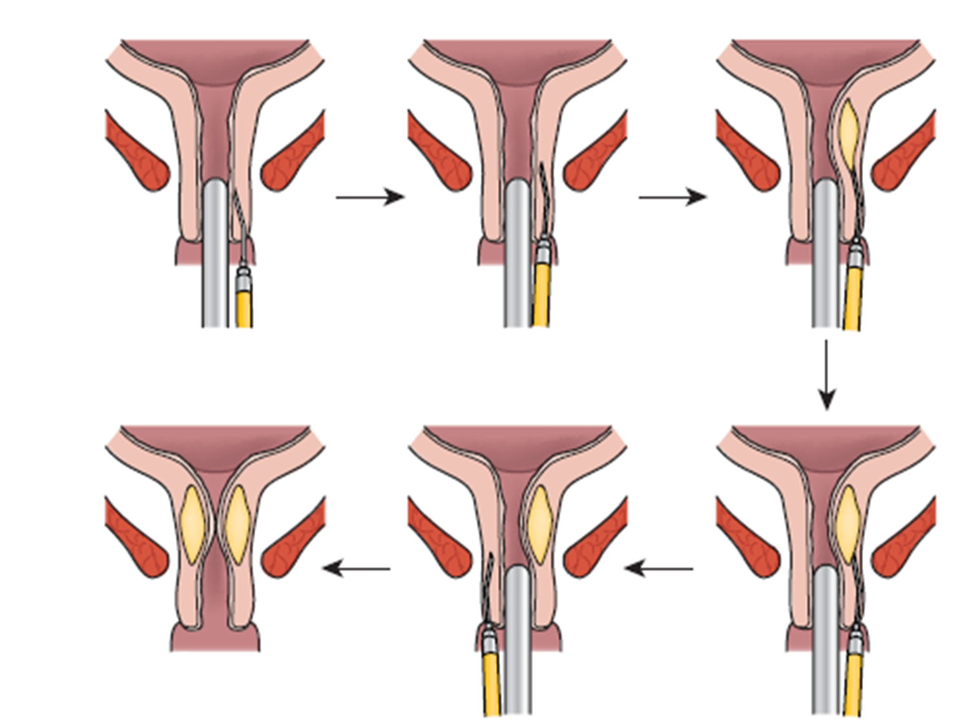
Urethral bulking agents

Slide 40
These agents are used in some patients with recurrent or refractory incontinence after a prior incontinence procedure
( grade 2C )
1 – Surgery has failed to achieve adequate symptom reduction
2 – Symptoms recur after surgery
3 – In women with symptoms who do not have urethral mobility
4 – In older women with comorbidities who can not tolerate anesthesia or more invasive surgery

Slide 41
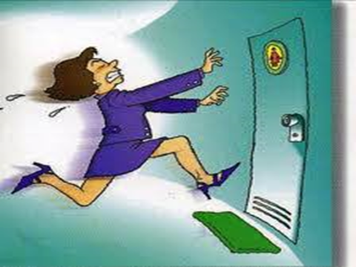
Overactive bladder (OAB) in females: Treatment

Slide 42
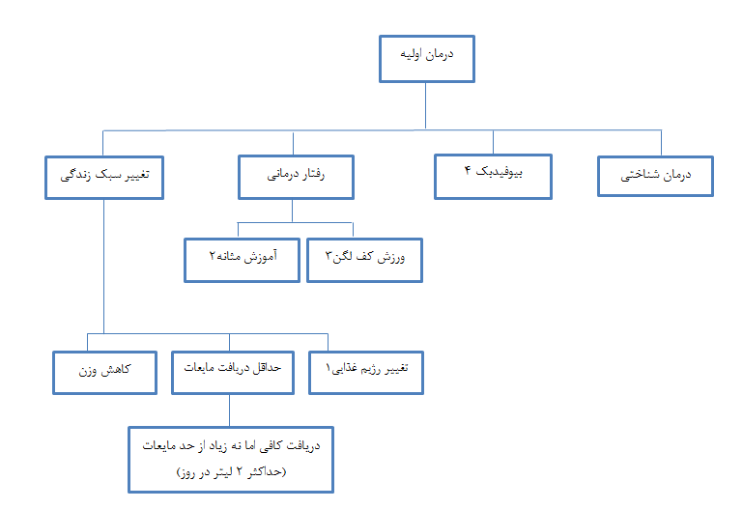

Slide 43
Trial of pelvic floor exercises / Lifestyle therapy / Behavioral changes
Supervised or augmented pelvic floor muscle training
It can take 6 to 12 weeks to see an effect from the initial interventions

Slide 44
For those who have difficulty or no improvement with unsupervised physical therapy:
Supervised pelvic floor physical therapy by a physical therapist specifically trained in the modalities (Grade 2C)

Slide 45
For patients in whom the initial treatments are ineffective, we suggest adding a trial of medication (Grade 2C).
Combination therapy appears more effective than either approach alone.

Slide 46
MEDICATION PRESCRIBING DETAILS
** Beta-3 adrenergic agonists :
1 – Mirabegron ( 25 & 50 mg )
2 - Vibegron ( 75 mg )
** Antimuscarinics agents:
1 - Tolterodine 2 mg
2 - Oxybutynin 5 mg
3 - Darifenacin 7.5 mg
4 - Fesoterodine 4 mg
5 – Solifenacin 10 mg

Slide 47
Beta-3 adrenergic agonist drugs and antimuscarinic agents are the main options for treatment of OAB symptoms
Efficacy is similar for the two groups
Suggest : initial drug treatment with beta-3 adrenergic agonists because of the increased risk of side effects, including long term risk of dementia, with anticholinergic drugs ( Grade 2 B )

Slide 48
Contraindications of Antimuscarinics agents :
1 - Uncontrolled tachyarrhythmias
2 - Myasthenia gravis
3 - Gastric retention
4 - Narrow angle-closure glaucoma
** They are used with caution :
1 - Cognitive impairment
2 - Urinary retention
3 - Gastric retention

Slide 49
Adverse drug effects :
1 - Urinary retention
2 - Risk of dementia
3 - Dry mouth
4 – Constipation
5 - Blurred vision for near objects
6 - Tachycardia
7 – Drowsiness
8 - Decreased cognitive function

Slide 50
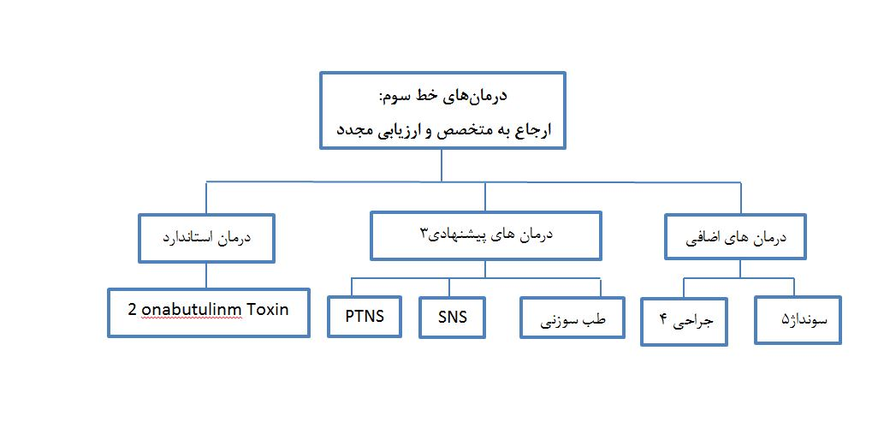

Slide 51
